Slide 1
Scalability in Model Checking
Course: CS60030
FORMAL Systems
Pallab Dasgupta
Professor,
Dept. of Computer Sc & Engg

Slide 2
Handling Large State Spaces
State Explosion
If M has k state variables, then it has 2^{k} states
Not all these states are reachable
Not all state variables are relevant for a property we wish to prove
Representation
Symbolic – we will never actually generate the explicit state space
Reduced – throw out those state variables that are inconsequential
Decision strategies
Proving the property on an abstraction of M may be sufficient
Proving the property assuming all states are reachable may be sufficient

Slide 3
More on scalability
BDD, SAT, SMT
Not good enough for many of the state spaces where we wish to use formal methods
OPTIONS (we will elaborate each of these)
BOUNDED SEARCH
In many cases we may know an upper-bound on the length of potential counter-examples
We can unfold only up to that depth
INDUCTION
We can inductively prove certain properties with limited unfolding
ABSTRACTION – REFINEMENT
We reduce the complexity of the STS by dropping some of its variables and prove that the abstraction is safe

Slide 4
BOUNDED MODEL CHECKING

Slide 5
Bounded Model Checking
Represent sets of states and the transition relation as Boolean logic formulas
Instead of computing the fixpoints, unroll the transition relation up to certain fixed bound and search for violations of the property within that bound
Transform this search to a Boolean satisfiability problem and solve it using a SAT solver

Slide 6
Example: Bound=2
Is there a witness of length=2?
r1
g1
Clauses from Transition Relation:
C₁¹: r2⁰ ∧ ¬ r1⁰ ∧ ¬ g1⁰ ⇒ g2¹
C₂¹: r1⁰ ⇒ g1¹
g2
r2
Clauses from Initial State:
I: g2⁰ ∧ ¬g1⁰
Clauses from Property: F( r1 ∧ (¬Xg1 ∨ ¬XXg1) )
Z¹: r1⁰ ∧ ¬ g1¹
SAT Check: Is Z¹ ∧ I ∧ C₁¹ ∧ C₂¹ satisfiable?
Answer: No, since Z¹ conflicts with C₂¹

Slide 7
Example: Bound=3
Is there a witness of length=3?
Clauses from Transition Relation:
C₁¹, C₂¹: from previous iteration
C₁²: r2¹ ∧ ¬ r1¹ ∧ ¬ g1¹ ⇒ g2²
C₂²: r1¹ ⇒ g1²
r1
g1
g2
r2
Clauses from Initial State:
I: g2⁰ ∧ ¬g1⁰
Clauses from Property: F( r1 ∧ (¬Xg1 ∨ ¬XXg1) )
Z²: (r1⁰ ∧ ( ¬g1¹ ∨ ¬g1² )) ∨ (r1¹ ∧ ¬g₁²)
SAT Check: Is Z² ∧ I ∧ C₁¹ ∧ C₂¹ ∧ C₁² ∧ C₂² satisfiable?
Yes: Witness: r1⁰ = 1, r1¹ = 0, g1¹ = 1, g1² = 0, rest are don’t cares
Conclusion: We have found a bug!!

Slide 8
What Can We Guarantee?
Note that we are checking only for bounded paths (paths which have at most k+1 distinct states)
So if the property is violated by only paths with more than k+1 distinct states, we would not find a counter-example using bounded model checking
Hence if we do not find a counter-example using bounded model checking we are not sure that the property holds
However, if we find a counter-example, then we are sure that the property is violated since the generated counter-example is never spurious (i.e., it is always a concrete counter-example)

Slide 9
Proving Correctness
If we can find a way to figure out when we should stop then we would be able to provide guarantee of correctness.
There is a way to define a diameter of a transition system so that a property holds for the transition system if and only if it is not violated on a path bounded by the diameter.
So if we do bounded model checking using the diameter of the system as our bound, then we can guarantee correctness if no counter-example is found.

Slide 10
Formal Methodology
Bound on path length k
Clauses describing the system M :
- Initial state : I(s₁)
- Unrolled transition relation : Λ_{i=1..k-1} T(s_{i} , s_{i+1})
Loop clause loop_{k} = V_{i=1..k} T(s_{k} , s_{i})
[f]_{i,k} means that temporal property f is true at runs starting from s_{i} and provable in k BMC iterations.
For the property f to hold on the system M Λ [f]_{1,k} must be valid.

Slide 11
Translation of LTL to SAT
Xf is true at state s_{i} , iff f is provable starting from s_{i+1}
[ X f ]_{i,k} = (i < k ) Λ [ f ]_{i+1,k}
Ff is true in state s_{i} , iff f is provable within k iterations from some future state s_{j}
[ F f ]_{ik} = V_{j=i..k} [ f ]_{j,k}
Gf is true in state s_{i} , iff f is true at all states reachable in k iterations and all paths loop
[ G f ]_{i,k} = Λ_{j=i..k} [ f ]_{j,k} Λ loop_{k}
f U g is true at s_{i} , iff g is provable from some state reachable within k iterations and f is provable from all preceding states within k iterations
[ f U g ]_{i,k} = V_{j=i..k}( [ g ]_{j,k} Λ Λ_{n=i..j-1}[ f ]_{n,k})

Slide 12
INDUCTION

Slide 13

The intuitive basis for induction
State transition system
Is any bad state reachable
from any initial state?
BAD
STATES
Suppose we prove the following:
All initial states are good, and
The transition relation does not allow any transition from a good state to a bad state
Then inductively, we are safe
INITIAL
STATES
Let p be the formula representing bad states
Then we check:
Whether Q₀ ∧ p is empty
Whether PreImage(p) ∧ ¬p is empty
If both are true, then we have inductively shown that bad states are unreachable

Slide 14
The notion of k-induction
State transition system
Is any bad state reachable
from any initial state?
BAD
STATES
INITIAL
STATES
For k= 0, 1, ….
1. Check whether any state reachable from Q₀ in k or fewer steps is bad.
If so, report counterexample and exit.
2. Check whether R guarantees that there is no transition to a bad state after k safe steps
If so, exit with success.
3. Otherwise continue to the next iteration
For finite state systems we can guarantee that the above will terminate in a finite number of iterations.

Slide 15
ABSTRACTION REFINEMENT

Slide 16
Cone-of-influence reduction
Two state variables
b and d
The value of f is influenced by:
Input a
State S1
The value of g is influenced by:
Input b
State S2
State S1, because S2 is influenced by it
Input a, because S1 is influenced by it
Computable using static analysis
a
x
f
y
S1
S2
z
g
b
w

Slide 17
Abstraction
Cone-of-influence reduction with respect to a property does not loose any relevant information
The problem is that quite often COI is not enough
Abstractions further reduce the size of the state machine
What kind of abstractions do we want?
Bugs must not escape detection.
This is guaranteed by the following constraint:
Any run which exists in the original state machine must also exist in the abstract state machine
This is achieved by existential abstraction of the transition relation

Slide 18
Existential Abstraction
10
In this example, we eliminate x₂
Let h(s) denote the abstract state corresponding to a state s in the original machine
Existential abstraction:
T(s_{a}, s_{b}) ⇒ T′( h(s_{a}), h(s_{b}) )
In other words:
T′( s_{i}, s_{j} ) ⇒ ∃ s_{a}, s_{b} T(s_{a}, s_{b}) such that
h(s_{a}) = s_{i} and h(s_{b}) = s_{j}
00
11
01
T(x₁, x₂)
0
1
T′(x₁)

Slide 19
Existential Abstraction
Corresponding to every run in the original state machine, we have a run in the abstract state machine
Therefore counterexamples in the original machine (if any) are preserved in the abstract state machine
If a property holds on the abstract state machine, then it also holds in the original state machine
Problem: A counterexample found in the abstract state machine is not necessarily real

Slide 20
False counterexample
10
Consider the property
G( x₁ ⇒ G ( x₁) )
Whenever x₁ goes high, it stays high
This is true in the original state machine
(look at the reachable states only)
But it is false in the abstract state m/c
00
11
01
T(x₁, x₂)
0
1
T′(x₁)

Slide 21

Abstraction Refinement
Abstract State M/C +
Properties
model checker
PASS?
yes
Refine the abstraction
no
counterexample analysis
no
Real Cex?
yes

Slide 22
Building Abstract Model
T′ can be computed efficiently if T is in functional form, e.g. sequential circuits.
Eliminated state variables are treated as free variables (inputs)
x1 x2 x3 x4
x1 x2
Abstract
i1 i2
i1 i2 x3 x4

Slide 23
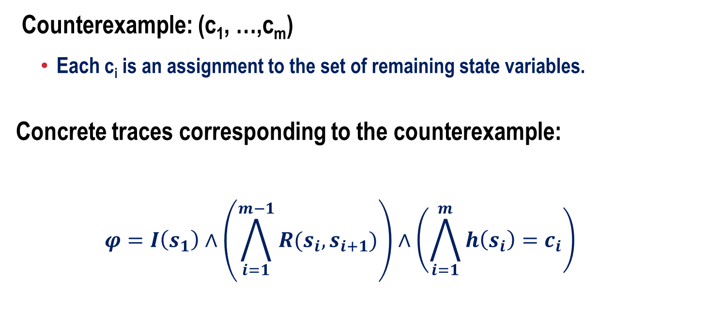
Checking the Counterexample
Counterexample: (c₁, …,c_{m})
Each c_{i} is an assignment to the set of remaining state variables.
Concrete traces corresponding to the counterexample:
$$φ=I\left(s_{1}\right)∧\left(\bigwedge_{i=1}^{m−1}{R(s_{i},s_{i+1})}\right)∧\left(\bigwedge_{i=1}^{m}{h\left(s_{i}\right)=c_{i}}\right)$$
Initial State
Unrolled Transition
Relation
Compliance with
counterexample

Slide 24
Abstraction/Refinement with conflict analysis
Simulate counterexample on concrete model with SAT
If the instance is unsatisfiable, analyze conflict
Make visible one of the variables in the clauses that lead to the conflict
Source: Chauhan, Clarke, Kukula, Sapra, Veith, Wang, FMCAD 2002

Slide 25
Why do we get spurious counterexample?
Deadend
states
I
I
f
Bad
States
Failure
State

Slide 26
Refinement
Problem: Deadend and Bad States are in the same abstract state.
Solution: Refine abstraction function.
The sets of Deadend and Bad states should be separated into different abstract states.
Deadend
states
I
I
f
Bad
States
Failure
State

Slide 27
Refinement
h’
h’
h’
h’
h’
h’
h’
Refinement : h’

Slide 28
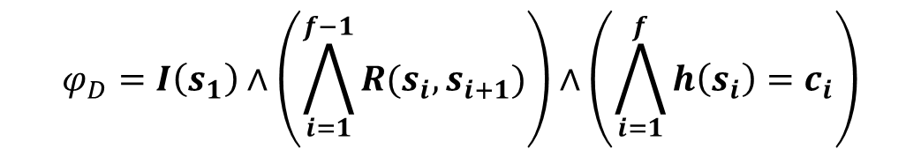
Refinement
Deadend States
$$φ_{D}=I\left(s_{1}\right)∧\left(\bigwedge_{i=1}^{f−1}{R(s_{i},s_{i+1})}\right)∧\left(\bigwedge_{i=1}^{f}{h\left(s_{i}\right)=c_{i}}\right)$$

Slide 29
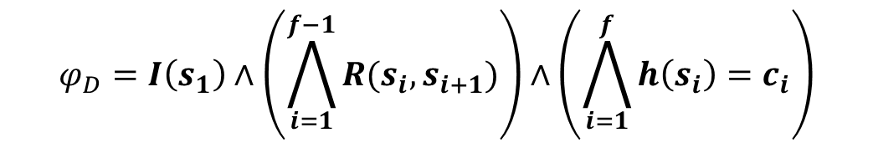
Refinement
$$φ_{D}=I\left(s_{1}\right)∧\left(\bigwedge_{i=1}^{f−1}{R(s_{i},s_{i+1})}\right)∧\left(\bigwedge_{i=1}^{f}{h\left(s_{i}\right)=c_{i}}\right)$$
Deadend States
Is ϕ_{D} ∧ ϕ_{B} = Φ ?
Bad States
$$φ_{B}=R(s_{f},s_{f+1})∧h\left(s_{f}\right)=c_{f}∧h\left(s_{f+1}\right)=c_{f+1}$$

Slide 30
Refinement as Separation
d₁
0 1 0 1
0 1 0
1
0
Invisible
b₁
0 0 1 0
0 1 0
0
1
Visible
b₂
0 1 1 1
0 1 0
1
1
Refinement: Find subset U of I that separates between all pairs of dead-end and bad states. Make them visible.
U must be minimal !

Slide 31
Refinement as Separation
d₁
0 1 0 1
0 1 0
0
I
b₁
0 0 1 0
0 1 0
1
V
b₂
0 1 1 1
0 1 0
1
Refinement: Find subset U of I that separates between all pairs of dead-end and bad states. Make them visible.
U must be minimal !

Slide 32
Refinement as Separation
The state separation problem
Input: Sets D, B
Output: Minimal U ∈ I s.t.:
∀ d ∈D, ∀ b ∈B, ∃u∈ U. d(u) ≠ b(u)
The refinement h’ is obtained by adding U to V.

Slide 33
Separation methods
ILP-based separation
Minimal separating set.
Computationally expensive.
Decision Tree Learning based separation.
Not optimal.
Polynomial.

